Slide 1

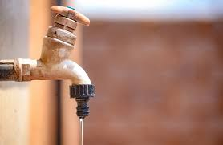


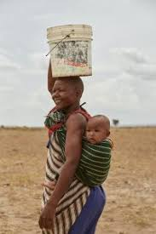

WATER AND SANITATION
www.reallygreatsite.com
Print(“Alpha”)
THEME: Mapping Intelligence
Health risks from waterborne diseases are increasing as access to clean water becomes more inconsistent.

Slide 2


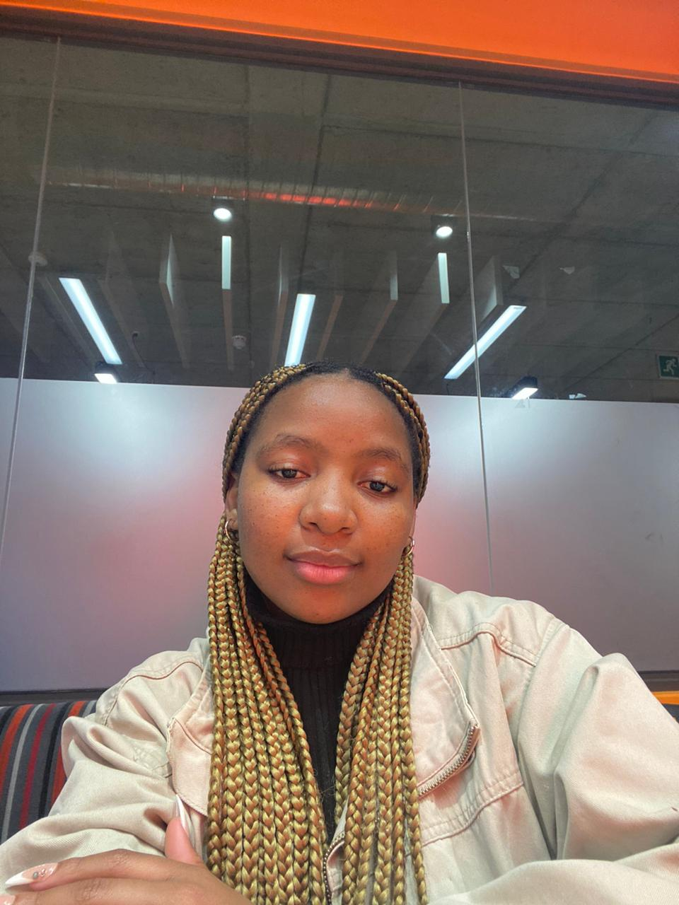


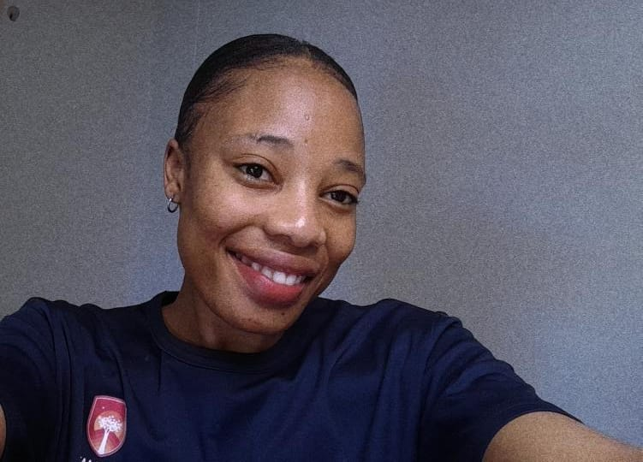

Calson Netshikulwe
Data Scientist
Praise Muzvondiwa
Back –End Developer
Yeyethu Songca
Back – End Developer
Awonke Nomandondo
Data Scientist
Vhutshilo Makhado
Data Scientist
Ayanda Khalo
Full Stack Developer

Slide 3
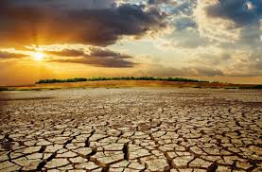


Problem Statement
The Northern Cape, South Africa’s driest province, faces a severe water service crisis. With annual rainfall averaging just 200 mm, far below the national average, the region’s 1.29 million residents are under constant threat from water shortages. (Statistics SA)
The province, with the lowest population density in the country (3 people/km²), has an outsized water demand due to agriculture and expanding communities, yet its decaying infrastructure is failing to cope. (DWSP Northern Cape)

Slide 4





PROPOSED SOLUTION: Scalable Smart Water Management System
1. Community-Based Water Leak Reporting Platform
Empowers citizens to report leaks OBSERVE UPDATES , improving transparency and speeding up issue resolution.
Mobile App/Web Interface
Geolocation API
Citizens report and upload pictures, which are automatically analyzed using image recognition
Pins the exact location of the leak, allowing maintenance teams to pinpoint areas.

Slide 5


Social Impact
Impact on Society
Job Creation
Addresses water shortages, improving citizen participation in water management and fostering transparency.
Jobs could be created in IoT sensor installation, data analytics, IT support, and community engagement.
SDG Goals
SDG 6: Clean Water and Sanitation
SDG 11: Sustainable Cities and Communities
SDG 9: Industry, Innovation, and Infrastructure
SDG 13: Climate Action
SDG 15: Life on Land

Slide 6


Business
COST STRUCTURE R360 000
MVP (Hardware and Software): R250 000
Marketing and Advertising: R60 000
Development(IT salaries and project fee): R50 000
REVENUE STREAMS
Water Data Monetization ( Water Flow Data, scarcity
Data)
DWS(Department of water and Sanitation) subscriptions
Private sector companies with large infrastructure
Advertising
Competitors:
CityWorks AMS
CarteGragh Assest management
G2 Deals
Technical Implementation:
92,1% Own Smart Device in NC.( SA News Agency )
…
Value Proposition: Using the communities' resources to solve the countries problems collaboratively using 4IR to improve optimized resources.

Slide 7
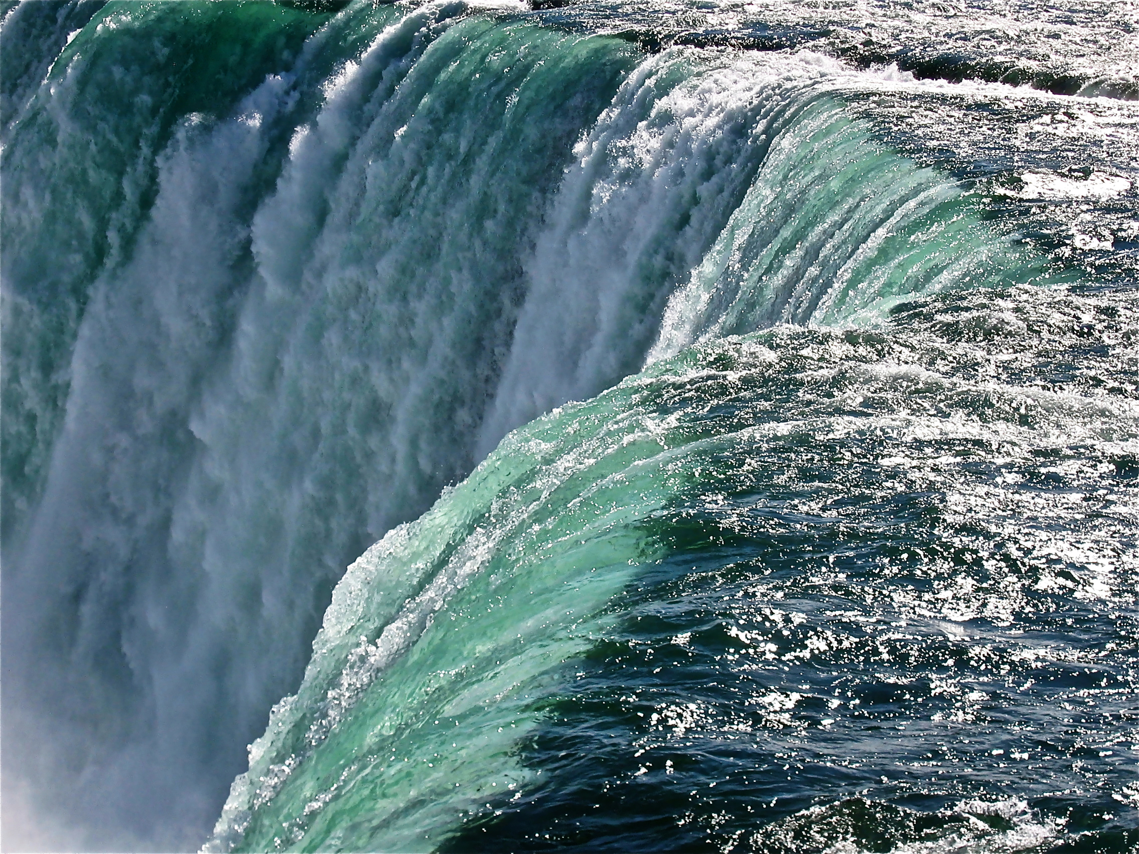
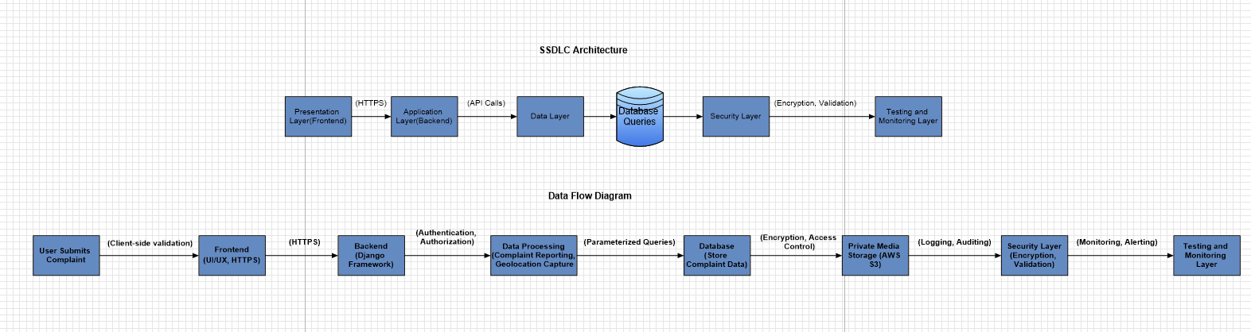

Architecture

Slide 8


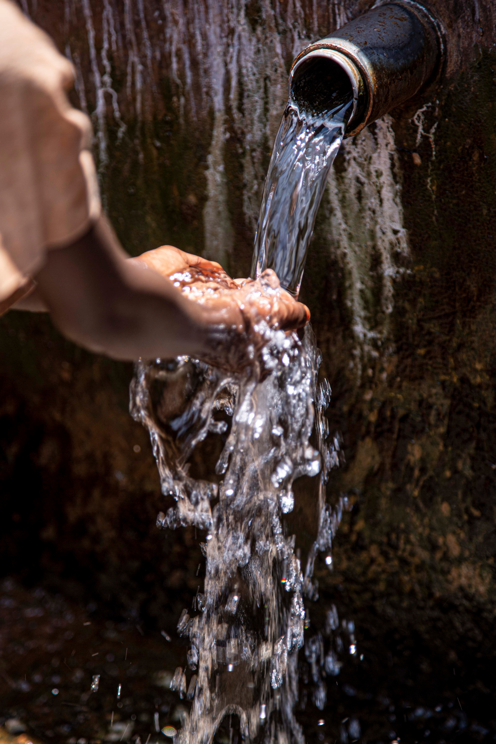
Security
A01: Broken Access Control
OWASP Top 10 Key Risks & Mitigations
Policies to consider:
POPI Act
Information Act
Importance of SSDLC: Mitigating OWASP Top 10 vulnerabilities at every phase ensures secure development, ongoing protection, and compliance with best practices.
Risk:
Unauthorized data access
Mitigation:
Implement RBAC (Role-Based Access Control) and strict permissions.
A03: Injection
Risk:
SQL/Command injections through forms
Mitigation:
Use parameterized queries and input validation.
A05: Security Misconfiguration
Risk:
Exposed settings due to misconfiguration
Mitigation:
Secure all Django settings, disable debug mode.

Slide 9

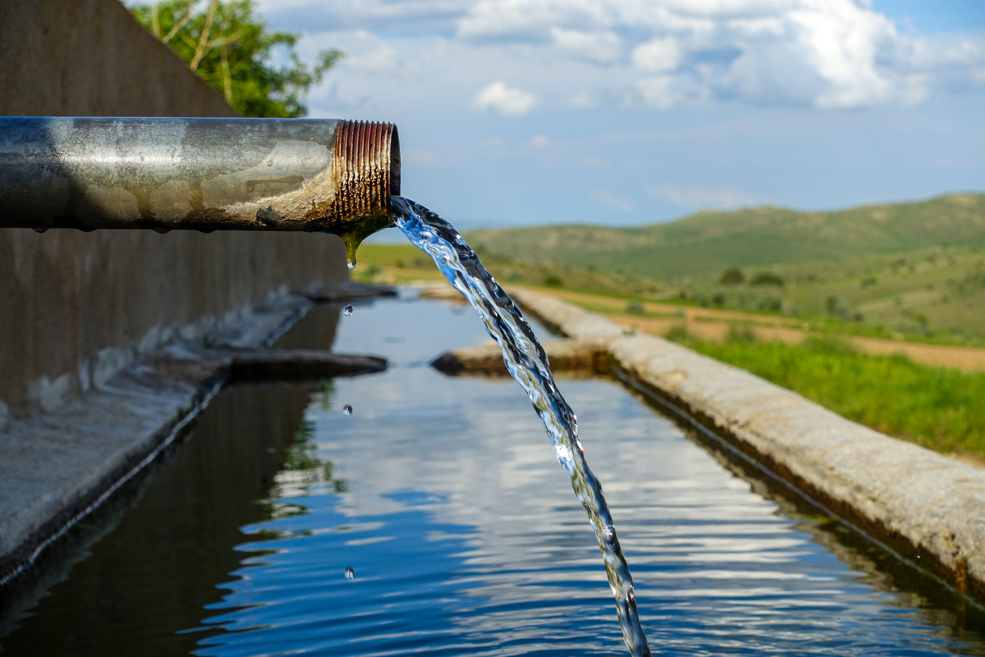
2. Maintenance and Infrastructure Dashboard
Provides authorities with live monitoring and data-driven insights to prioritize and address water infrastructure issues.
Centralized Dashboard
Provides water authorities with a live map of reported issues, sensor alerts, and maintenance progress.
System uses AI algorithms to prioritize repairs based on factors such as leak severity, population density, and infrastructure vulnerability.
Priority-Based Response System

Slide 10
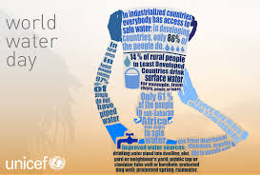
THANK YOU!
www.reallygreatsite.com

